Slide 1
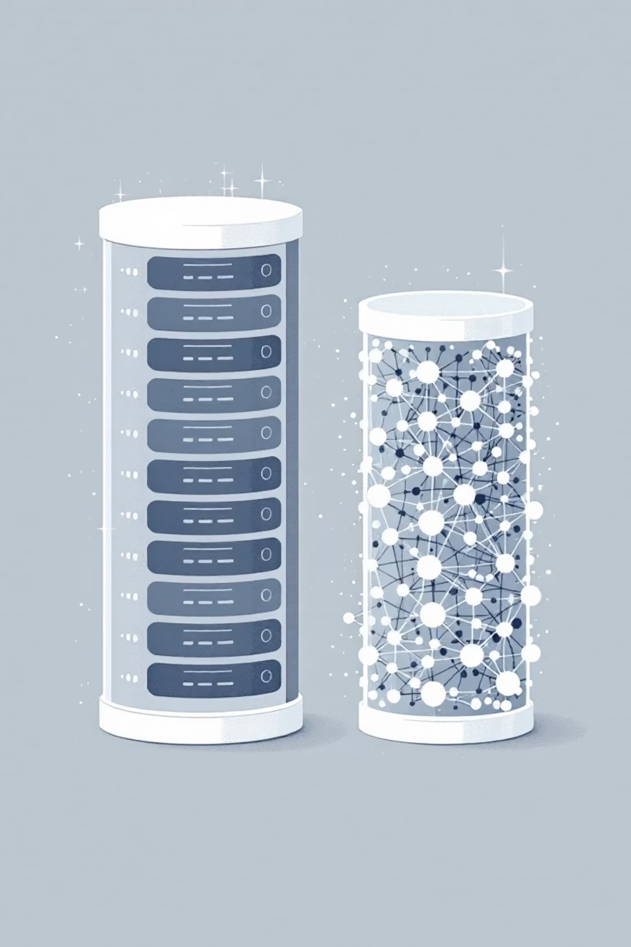
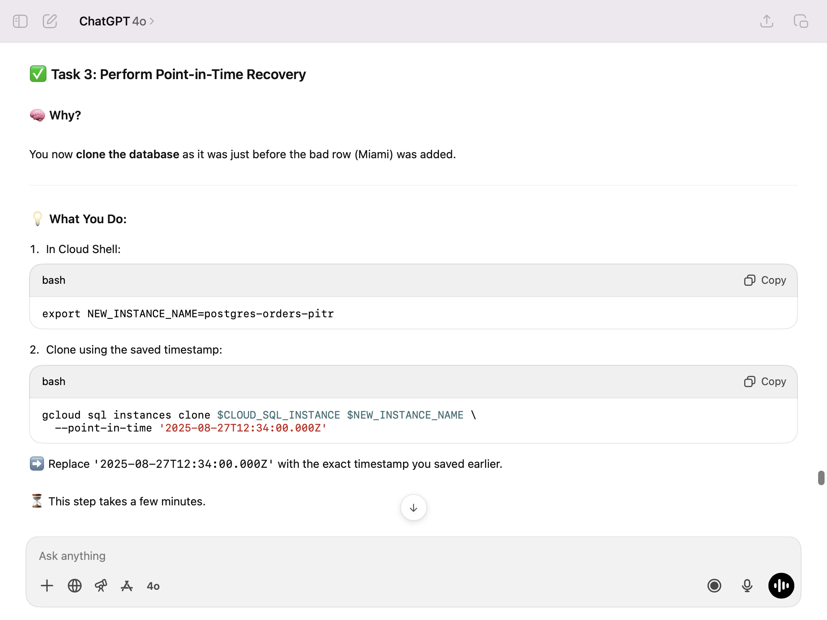
The Shift from Traditional to Gen AI Databases
Generative AI applications require a fundamentally different approach to storing and retrieving data compared to traditional applications. This presentation explores why vector embeddings are crucial and what factors to consider when choosing a Gen AI database.
Created by Aman
Notes:
Good morning, everyone. This presentation examines the paradigm shift in database technology necessitated by Generative AI. Unlike traditional applications, Gen AI relies heavily on vector embeddings for efficient data retrieval. We'll explore their importance and the key considerations for selecting the right Gen AI database.

Slide 2

Traditional vs. Gen AI Databases
Traditional Databases
Gen AI Databases
Store structured data in rows and columns
Handle unstructured data (text, images, audio)
Find data by matching exact values
Understand meaning and context
SQL queries for precise matches (e.g., "find all carnivores")
Find semantically similar items
Rely on vector embeddings
Created by Aman
Notes:
Slide Title: Traditional vs. Generative AI Databases
**(Speaker Notes):** This slide contrasts traditional and generative AI databases. Traditional databases excel at structured data, using SQL for precise searches based on exact matches. Gen AI databases, however, are designed for unstructured data like text and images. They leverage vector embeddings to understand meaning and context, enabling semantic searches – finding similar items even without exact keyword matches. This represents a significant shift in data retrieval capabilities.

Slide 3



What Are Vector Embeddings?
A vector embedding converts unstructured data—like words, sentences, or images—into a list of numbers (a vector) representing its position in a high-dimensional space.
Unstructured Data
Embedding Process
Vector Database
Text, images, audio files
Convert to numerical vectors
Store in high-dimensional space
The key feature: semantically similar items are placed closer together in this space. For example, "lion" and "tiger" vectors would be close, while "car" would be far away.
Created by Aman
Notes:
Slide Title: What are Vector Embeddings?
(Speaker Notes) Good morning/afternoon. This slide explains vector embeddings. Essentially, we transform unstructured data (like text or images) into numerical vectors. These vectors are stored in a high-dimensional space in a vector database. The magic? Semantically similar items – like "lion" and "tiger" – are clustered together, enabling efficient similarity search. This is a key technology for many AI applications. (Created by Aman)

Slide 4

Semantic Search with Vector Embeddings
Traditional Search
Semantic Search
"Find the animal named 'lion'"
"Find animals similar to a 'lion'"
Exact match required
Returns tigers, leopards, cheetahs
Misses related concepts
Understands relationships
Limited to structured data
Works with unstructured data
Created by Aman
Notes:
Slide Title: Semantic Search with Vector Embeddings
**(Speaker Notes):** This slide contrasts traditional keyword search with semantic search using vector embeddings. Traditional search relies on exact keyword matches, limiting results and missing related concepts. It struggles with unstructured data. In contrast, semantic search understands context and relationships, finding similar items even with variations in wording. The example highlights how "similar to a lion" yields related animals, showcasing the power of vector embeddings. (Created by Aman).

Slide 5

Key Factors for Choosing a Gen AI Database
Support for Vector Search
Database must efficiently store vectors and perform fast similarity searches
Examples: AlloyDB, Spanner, and Cloud SQL for PostgreSQL
Integration with AI/ML Platforms
Should connect easily with AI platforms like Google's Vertex AI to simplify creating embeddings and using foundation models
Created by Aman
Notes:
Slide Title: Choosing the Right Gen AI Database
Good morning/afternoon. This slide highlights key considerations when selecting a database for your generative AI applications. Crucially, it needs robust **vector search** capabilities for efficient similarity searches on your embedded data. Examples include AlloyDB, Spanner, and Cloud SQL for PostgreSQL. Seamless **integration with your AI/ML platform**, such as Google Vertex AI, is also paramount for streamlined embedding creation and foundation model utilization.

Slide 6



Scale and Performance
Gen AI deals with enormous datasets and requires rapid responses.
AlloyDB
Spanner
Memorystore
Extremely fast queries (transactional, vector, and analytical)
Scales almost infinitely to handle global traffic and massive datasets, ideal for large language models
In-memory storage for caching, offering fastest possible data access for frequently used information
Created by Aman
Notes:
Slide: Scale & Performance
**(Speaker Notes):** Gen AI's success hinges on speed and scale. We address this with Google Cloud's powerful database solutions: AlloyDB for blazing-fast transactional, vector, and analytical queries; Spanner for virtually limitless scalability, perfect for large language models and global deployments; and Memorystore for ultra-fast in-memory caching of frequently accessed data. This robust infrastructure ensures optimal performance.

Slide 7
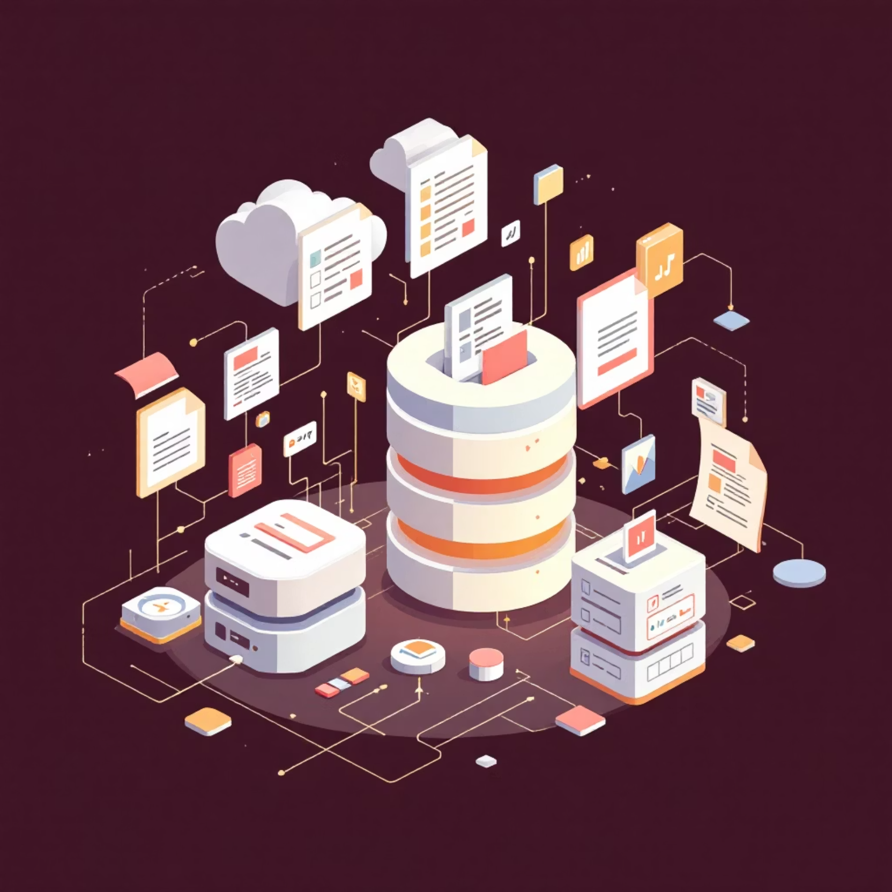
Data Flexibility
Gen AI applications often use diverse data types:
BigQuery
Best for analyzing petabyte-scale structured and semi-structured datasets
Firestore
Great for flexible, document-style data (unstructured or semi-structured) requiring real-time updates
Created by Aman
Notes:
Slide Title: Data Flexibility
(Presenter Note): Gen AI leverages diverse data sources. BigQuery excels with massive, structured datasets, ideal for large-scale analysis. Firestore offers flexibility for real-time updates on document-style data, better suited for dynamic, potentially unstructured information. This diverse approach enables robust AI model training and deployment.

Slide 8


Cost and Operational Efficiency
Storing huge amounts of data can be expensive.
Fully-managed databases like AlloyDB and Cloud SQL reduce the need for manual administration, which lowers operational costs.
When choosing a Gen AI database, consider both direct storage costs and the hidden costs of administration and maintenance.
Created by Aman
Notes:
Slide Title: Cost & Operational Efficiency
Speaker Notes: Managing massive datasets is costly. AlloyDB and Cloud SQL offer fully-managed solutions, significantly reducing operational overhead through automated administration. Remember to factor in both direct storage costs *and* the often overlooked costs of manual administration and maintenance when selecting a Gen AI database.

Slide 9

Security and Data Protection
Encryption
Access Control
Advanced Security
Databases like AlloyDB, Cloud SQL, Spanner, and Firestore automatically encrypt data both at rest and in transit
Integration with IAM (Identity and Access Management) lets you control exactly who can see or modify data
AlloyDB provides extra features like model endpoint management to protect your application from malicious attacks
Created by Aman
Notes:
Slide Title: Security and Data Protection
Key Points:
* **Data Encryption:** Our databases (AlloyDB, Cloud SQL, Spanner, Firestore) automatically encrypt data at rest and in transit.
* **Access Control:** Seamless IAM integration allows granular control over data access and modification.
* **Advanced Security:** AlloyDB offers advanced features, such as model endpoint management, for enhanced application protection.

Slide 10
Key Takeaways
Different Needs, Different Solutions
Choose the Right Database
Vector Embeddings Are Essential
Consider vector search support, AI integration, scale, flexibility, cost, and security
AlloyDB, Spanner, BigQuery, and Firestore each excel in different Gen AI scenarios
They enable semantic search and understanding of unstructured data
The shift to Gen AI databases represents a fundamental change in how we store, retrieve, and understand data.
Created by Aman
Notes:
**(Slide Title: Key Takeaways)**
Good morning/afternoon everyone. Let's recap.
* **Vector embeddings are crucial:** They unlock semantic search and understanding for unstructured data. This is fundamental to Gen AI.
* **Database selection is critical:** Factor in vector search capabilities, AI integration, scalability, flexibility, cost, and security.
* **No one-size-fits-all:** AlloyDB, Spanner, BigQuery, and Firestore each offer unique advantages for different generative AI use cases.
This shift towards Gen AI databases signifies a paradigm shift in data management. Thank you.

